Slide 1
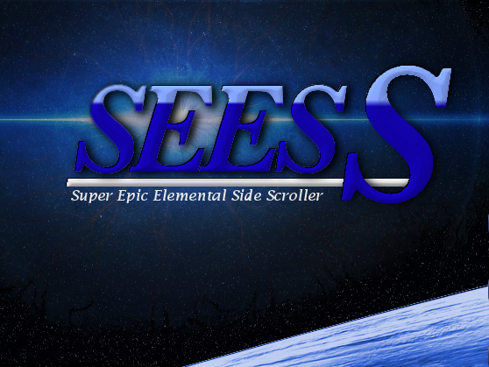
Class Explanation
-Corey Mellon

Slide 2
Class Breakdown
Main: -Space()
Screens(GUI): -MainMenuScreen()
-GameScreen()
-NextWaveShipScreen()
- NextWaveFireScreen()
-NextWaveLightningScreen()
- NextWaveWIndScreen()
Problem Domain: -Player()
-Enemy()
-Loot()
-Projectile()
Data Access: -PlayerDA()

Slide 3
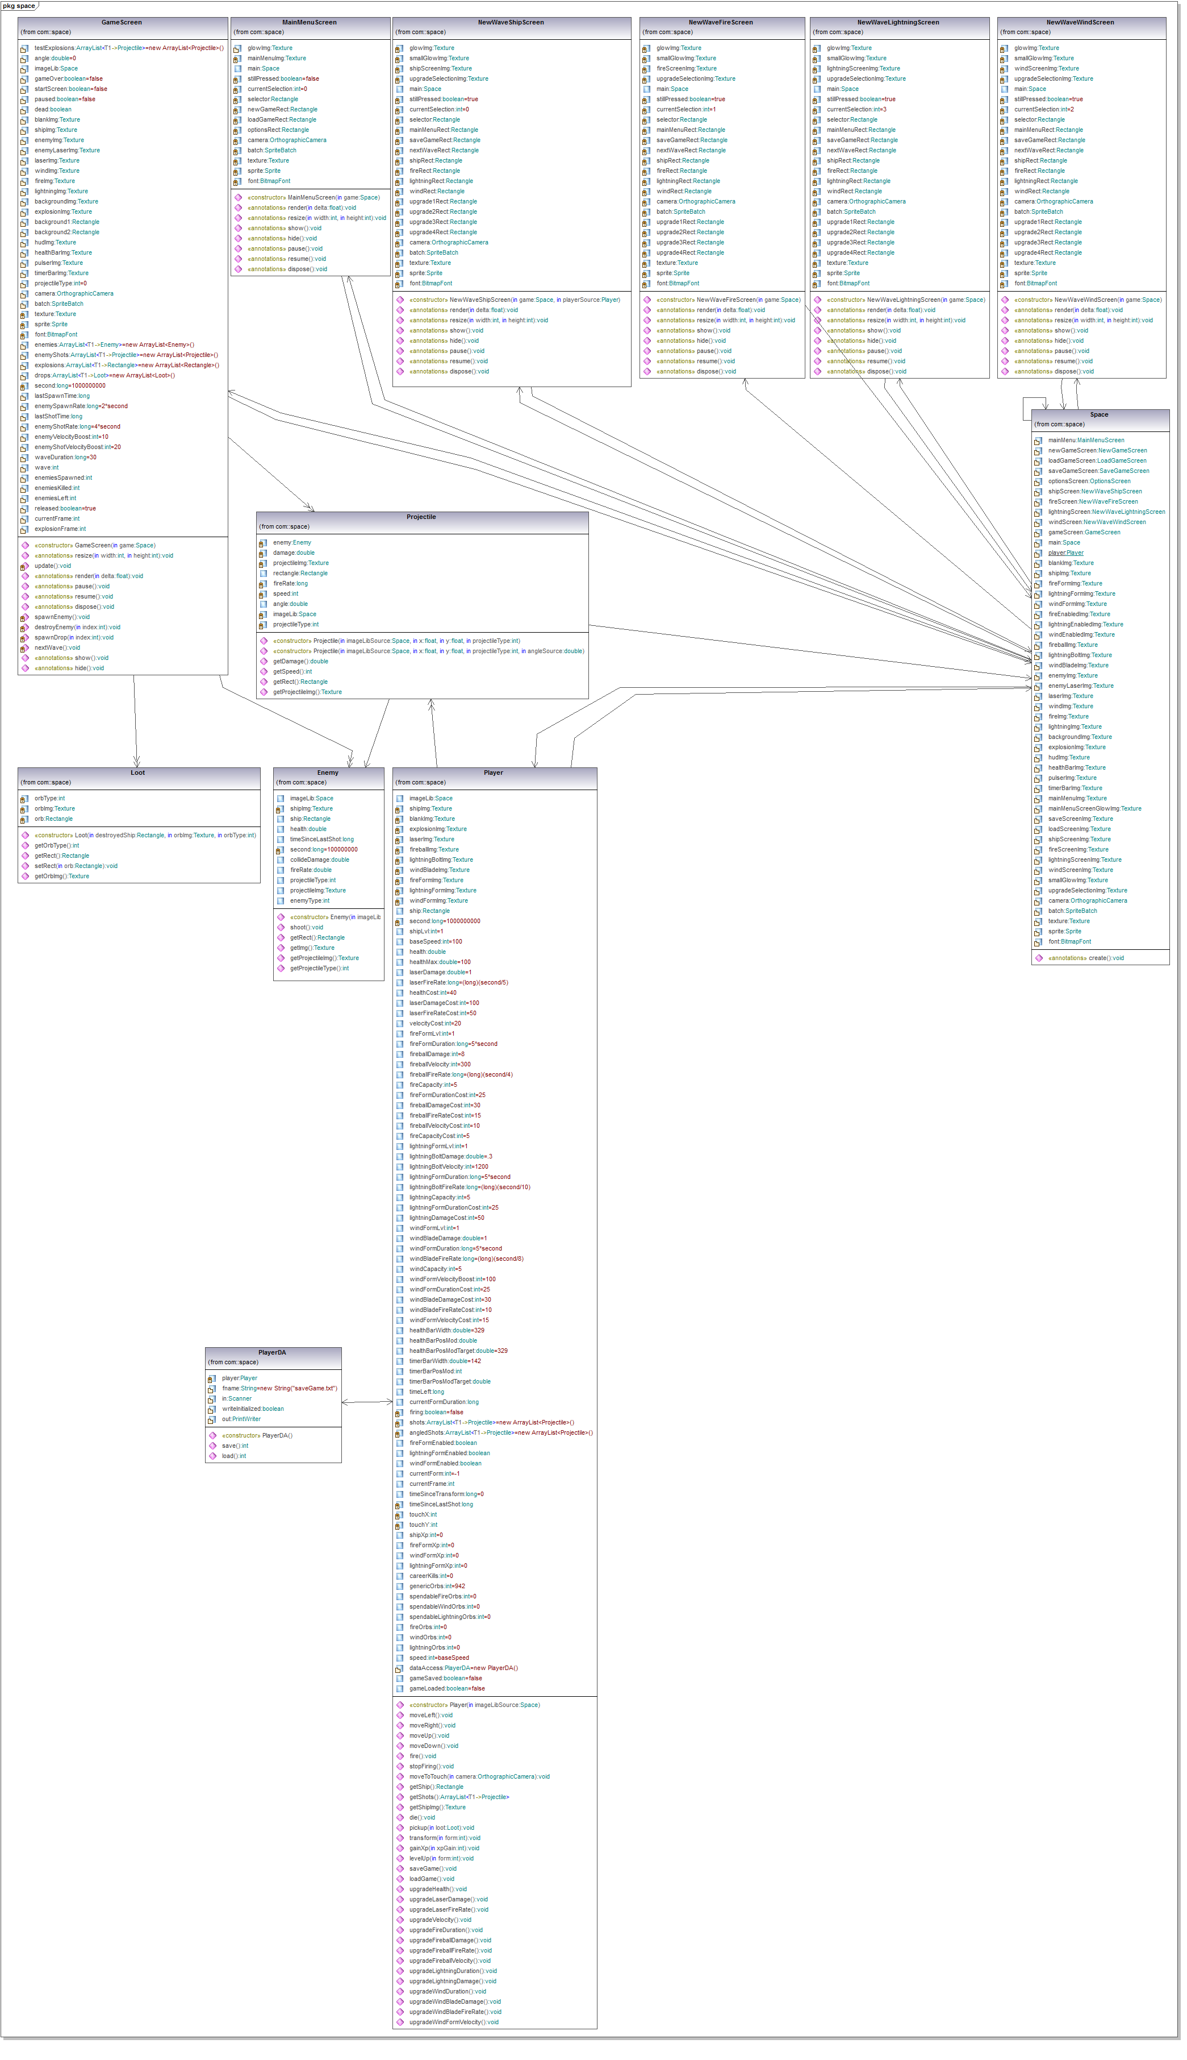
UML

Slide 4
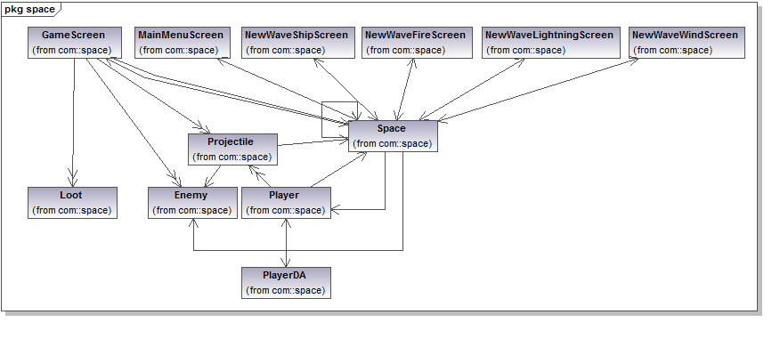
UML(Compact)

